Slide 1
Agentic UAVs
LLM-Driven Autonomy with Integrated
Tool-Calling and Cognitive Reasoning
SmartTech 2025 — AI and Autonomous Systems Track
Anis Koubaa¹ · Khaled Gabr²
¹AlfaisalX Center of Excellence, Alfaisal University, Saudi Arabia
²RIOTU Lab, Prince Sultan University, Saudi Arabia
December 25–27, 2025 | Tunis, Tunisia

Slide 2

AlfaisalX: Center of Excellence
▶ Institution: Alfaisal University, Riyadh, KSA
▶ Focus Areas:
▷ Cognitive Robotics & Autonomous Agents
▷ UAV/Drone Technologies
▷ AI & Large Language Models
▶ Collaboration: RIOTU Lab, Prince Sultan University
▶ Mission: Advancing intelligent aerial systems for defense, disaster response, and logistics
A. Koubaa & K. Gabr
SmartTech 2025
2 / 16

Slide 3
Problem Statement
The Challenge
UAVs are increasingly deployed in defense, surveillance, and disaster
response, yet most remain limited to SAE Level 2–3 autonomy.
▶ Reliance on rule-based control restricts adaptability
▶ Narrow AI limits response in dynamic environments
▶ No context-aware reasoning for complex missions
▶ No ecosystem integration with external services
Research Question
How can we design a UAV architecture that fuses LLM-driven
reasoning with real-time perception and ecosystem integration
for general-purpose autonomy?
A. Koubaa & K. Gabr
SmartTech 2025
3 / 16

Slide 4
Gap Analysis: Current UAV Limitations
Existing approaches fall short:
Approach | Strength | Limitation
Classical Control (A*, RRT*) | Efficient, deterministic | Fails under uncertainty
Reinforcement Learning | Adaptive policies | Low-dimensional only
Swarm Intelligence | Distributed coordination | No cognitive reasoning
LLM Integration (REAL, UAV-VLN) | Semantic parsing | Isolated planner only
Critical Gap
No UAV system leverages LLM agents with tool-calling for:
▷ Real-time knowledge access and API interaction
▷ Ecosystem-level integration (databases, alerts)
▷ Peer-to-peer reasoning in multi-agent swarms
A. Koubaa & K. Gabr
SmartTech 2025
4 / 16

Slide 5
Key Contributions
1. Architectural Novelty
▶ First five-layer architecture fusing LLM reasoning with continuous perception and flight control
2. Ecosystem Integration
▶ Novel Integration Layer enabling tool-calling, API interaction, and multi-agent protocols (MCP, ACP, A2A)
3. Collaborative Swarm Cognition
▶ First demonstration of distributed LLM-based reasoning for task negotiation among UAV swarms
Novelty
Transforms UAVs from isolated planners to networked cognitive agents
A. Koubaa & K. Gabr
SmartTech 2025
5 / 16

Slide 6
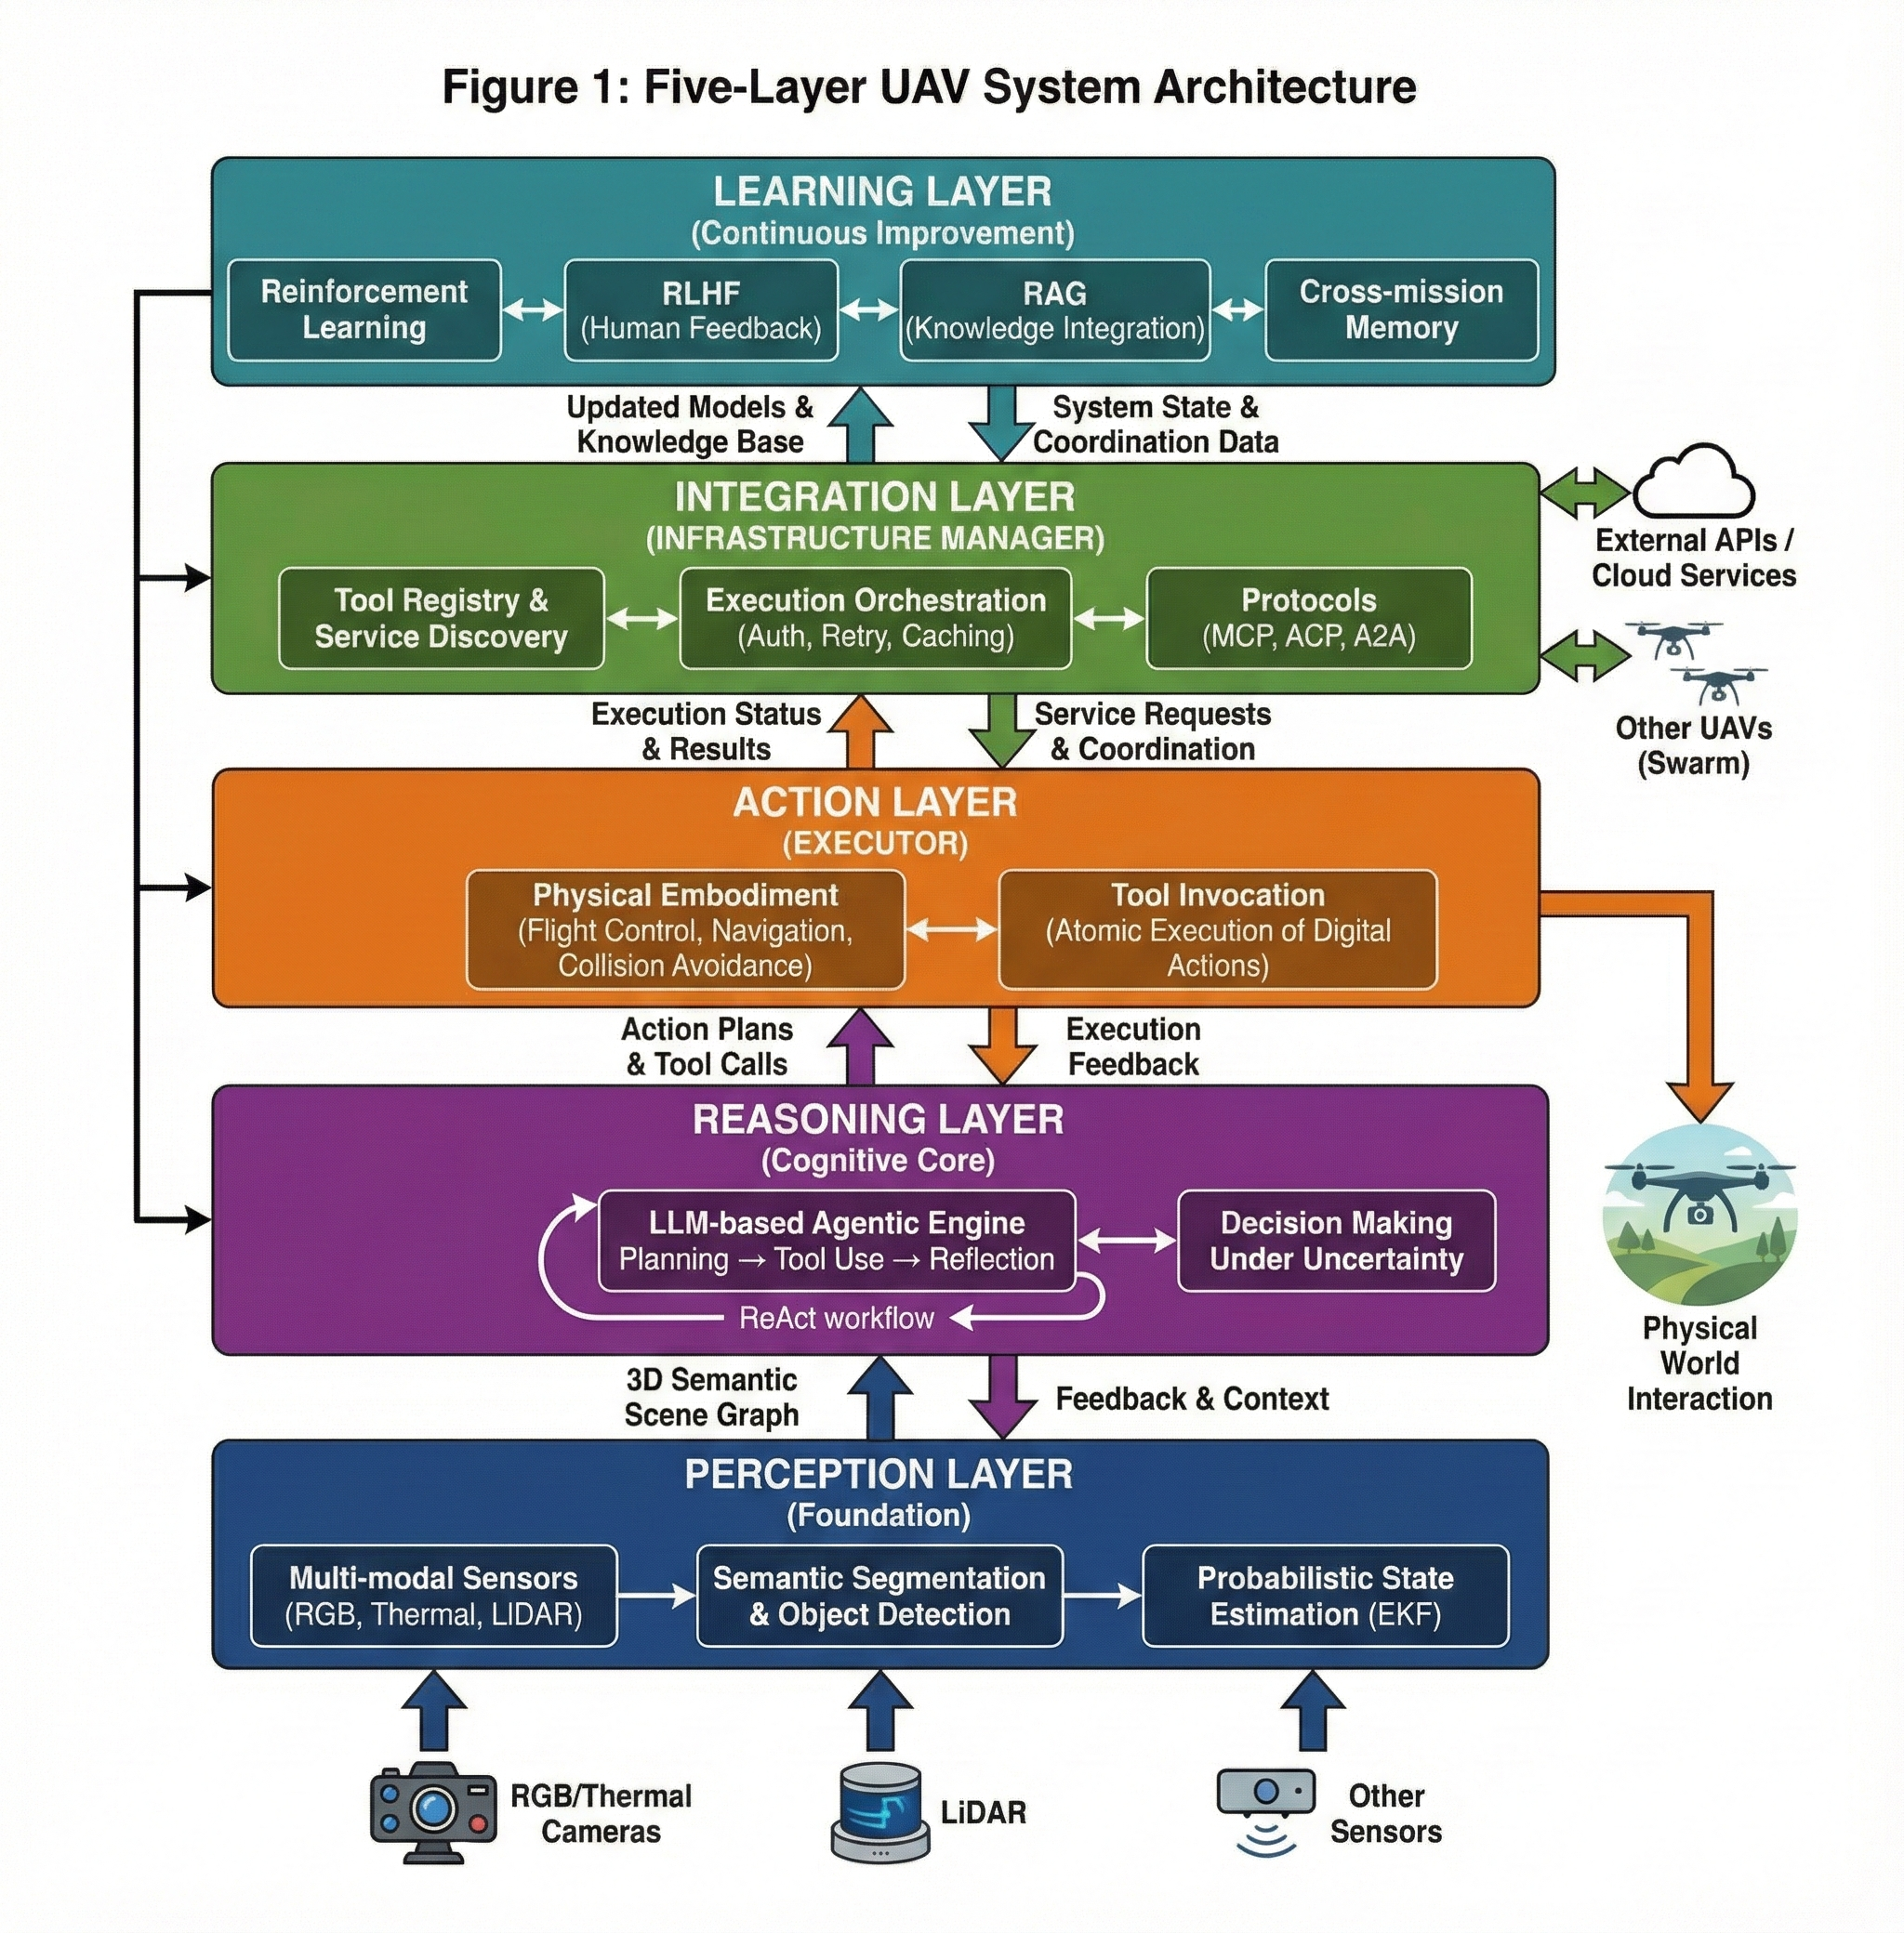
Methodology: Five-Layer Architecture
A. Koubaa & K. Gabr
SmartTech 2025
6 / 16

Slide 7
Reasoning Layer: LLM-Driven Cognition
ReAct Workflow
The LLM operates as a stateful agentic engine via LangGraph
▶ Planning: Decomposes high-level goals into action sequences
▶ Tool Use: Invokes APIs, databases, weather services
▶ Reflection: Monitors outcomes, triggers replanning on failure
{"goal": "Inspect anomaly", "steps": [{"action": "call_tool", "tool": "weather.get_forecast"}, {"action": "fly_to", "target": "Anomaly-01"}]}
Key Innovation
LLM decides what to do; Action Layer executes; Integration Layer manages how
A. Koubaa & K. Gabr
SmartTech 2025
7 / 16

Slide 8
Integration Layer: Ecosystem Connectivity
Transforms UAVs into networked digital actors:
▶ Tool Registry: Dynamic catalog of APIs, databases, services
▶ Execution Orchestration: Authentication, retry logic, caching
▶ Protocol-Governed Communication:
▷ MCP: Model Context Protocol for secure LLM tool use
▷ ACP: Agent Communication Protocol for UAV-to-cloud
▷ A2A: Agent-to-Agent for peer negotiation
▶ Security: mTLS, JWT tokens, prompt injection detection
Multi-Agent Coordination
Task allocation, spatial deconfliction, shared situational awareness
A. Koubaa & K. Gabr
SmartTech 2025
8 / 16

Slide 9
Experimental Validation: Setup
Simulation Environment:
▶ Platform: Gazebo Harmonic + PX4 SITL v1.14.3
▶ Middleware: ROS 2 Humble
▶ Perception: YOLOv11 @ 30 Hz (Intel RealSense D455)
▶ Reasoning: GPT-4 API + Local Gemma-3 (4B parameters)
▶ Hardware: Intel i7-13900K, 32GB RAM, RTX 4070
Scenario: Hajj Pilgrimage Search & Rescue
▶ Scenario 1: Normal activity monitoring (crowd surveillance)
▶ Scenario 2: Emergency medical intervention (collapsed person)
Dataset: n=44 samples per system, N=132 total detections
A. Koubaa & K. Gabr
SmartTech 2025
9 / 16

Slide 10
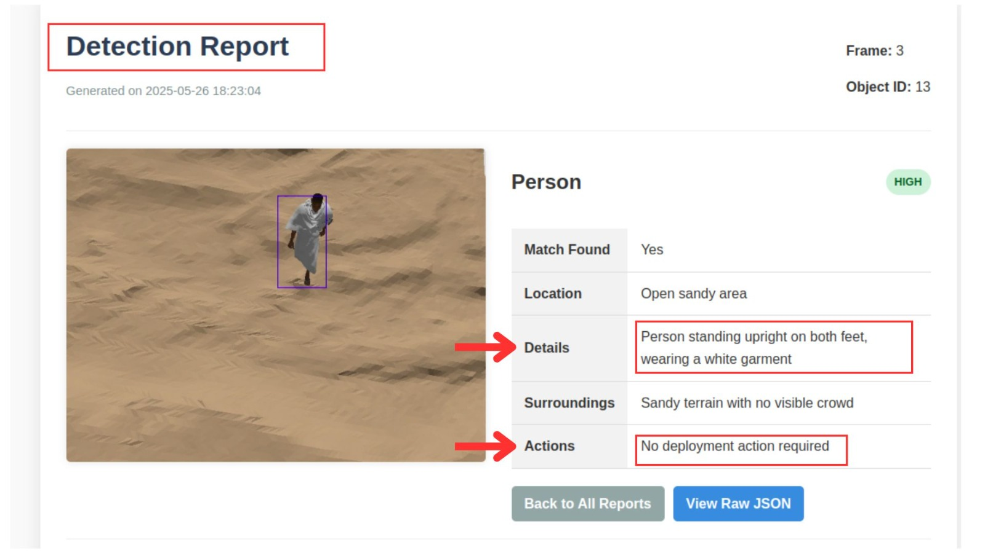
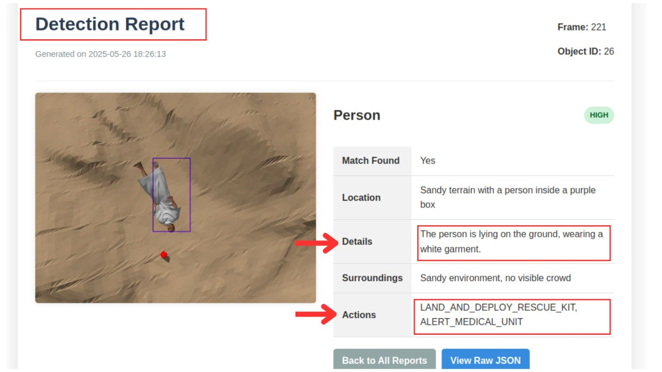
SAR Scenario Demonstrations
Scenario 1: Normal Monitoring
Scenario 2: Emergency Response
▶ Normal pilgrim activity detected
▶ Contextual understanding provided
✓ No intervention required
▶ Collapsed person detected (conf: 0.89)
▶ Emergency classified in < 3 sec
⚠ Alert + rescue kit deployed
A. Koubaa & K. Gabr
SmartTech 2025
10 / 16

Slide 11
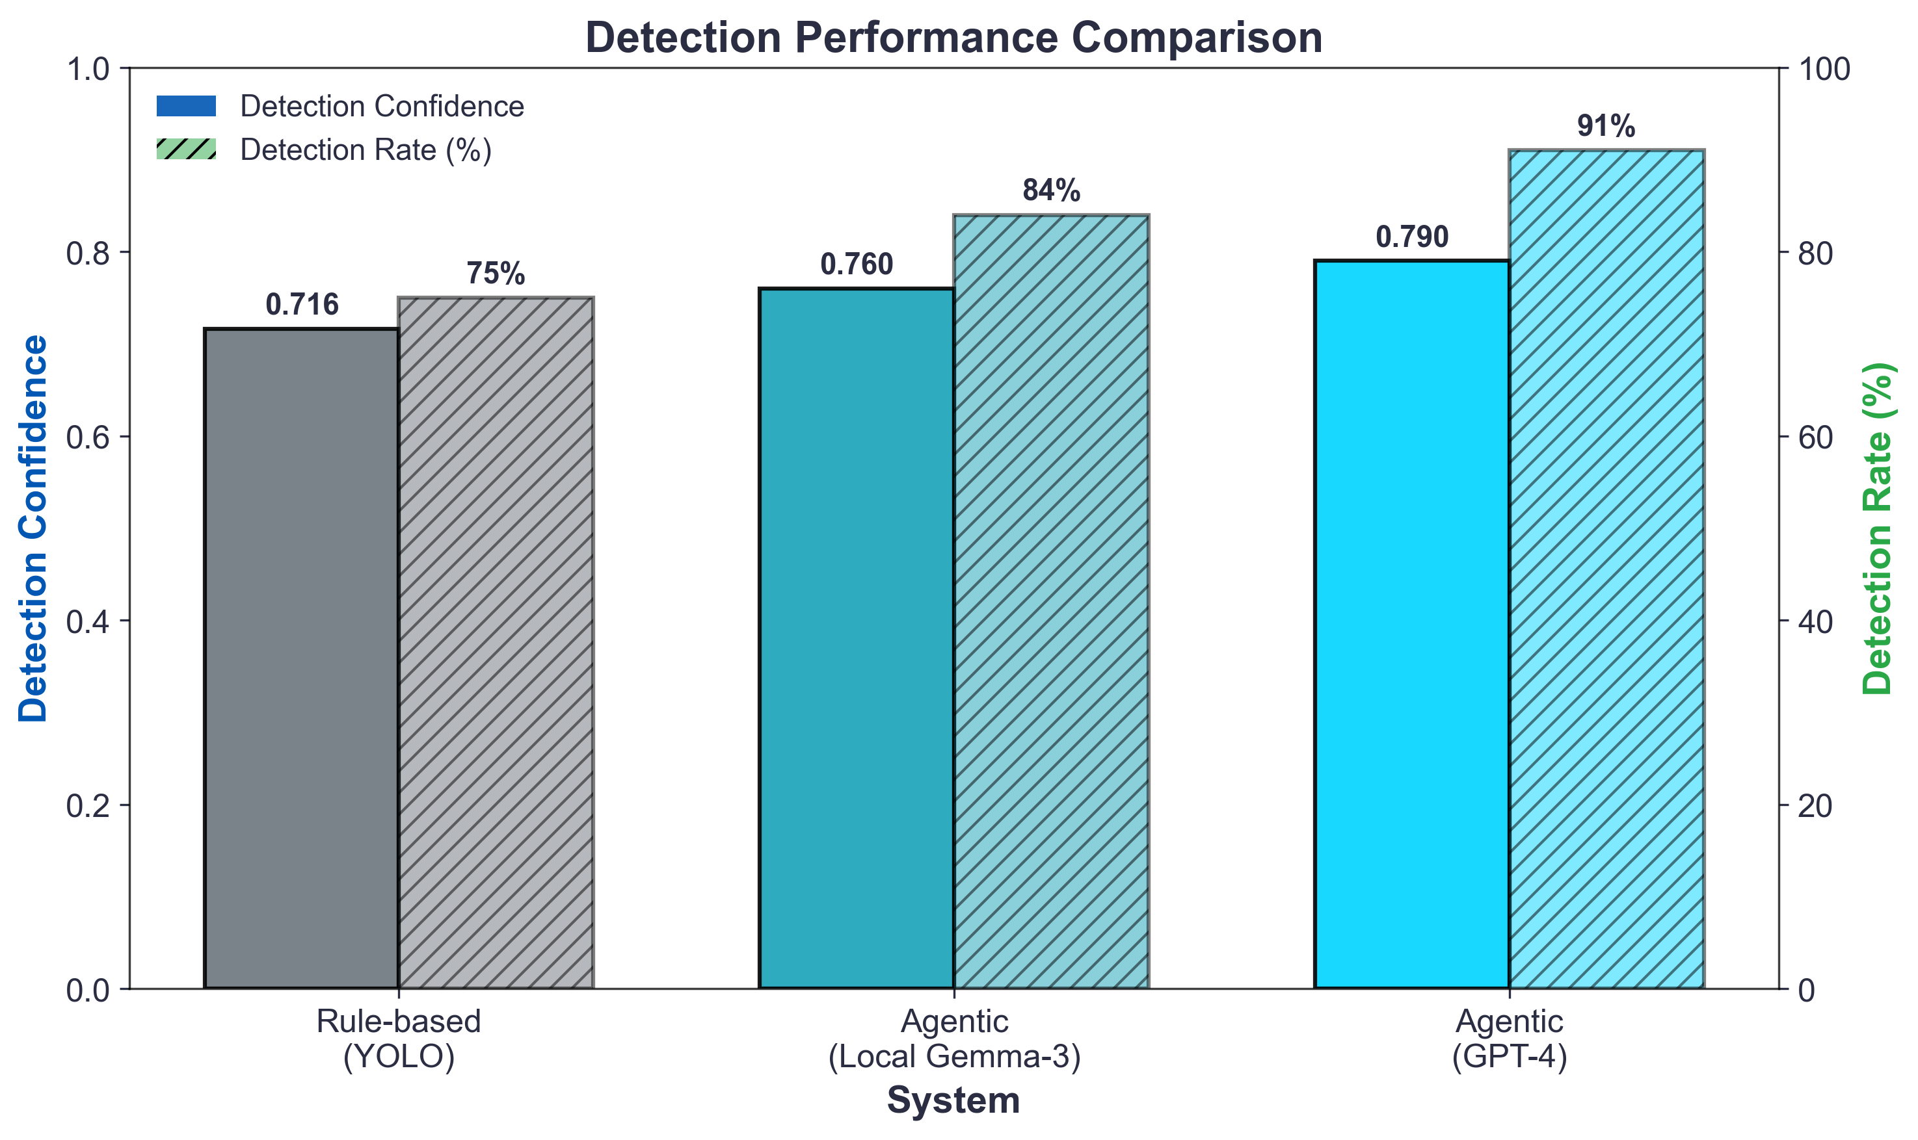
Results: Detection Performance
Metric | YOLO | Local | GPT-4
Confidence | 0.716 | 0.760 | 0.790
Detection | 75% | 84% | 91%
Key Results
+16% improvement in detection rate (91% vs 75%)
ANOVA: F(2,129) ≈ 3.96, p = 0.021
A. Koubaa & K. Gabr
SmartTech 2025
11 / 16

Slide 12
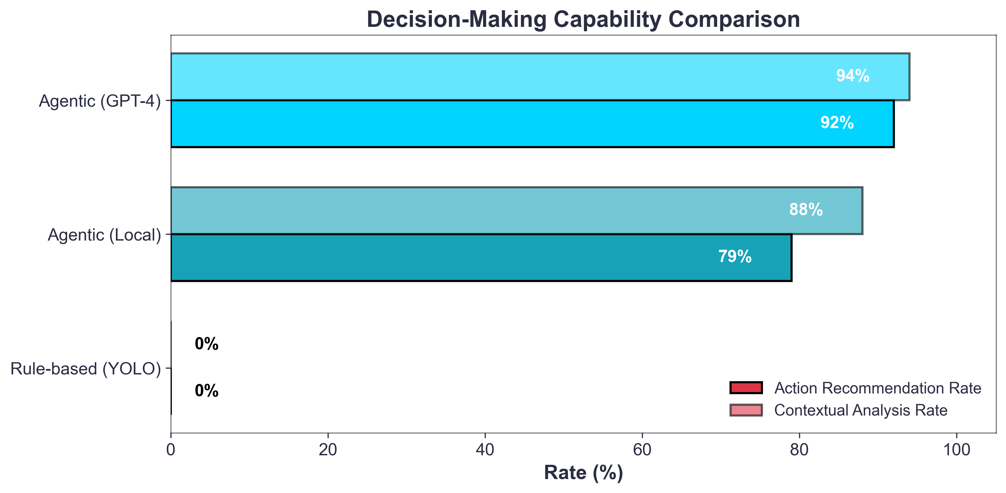
Results: Decision-Making Capability
Metric | YOLO | Local | GPT-4
ARR | 0% | 79% | 92%
CAR | 0% | 88% | 94%
Critical Finding
Rule-based: 0% autonomy
Agentic: 92% action rate
χ² = 82.92, p << 0.001, V = 0.79
A. Koubaa & K. Gabr
SmartTech 2025
12 / 16

Slide 13
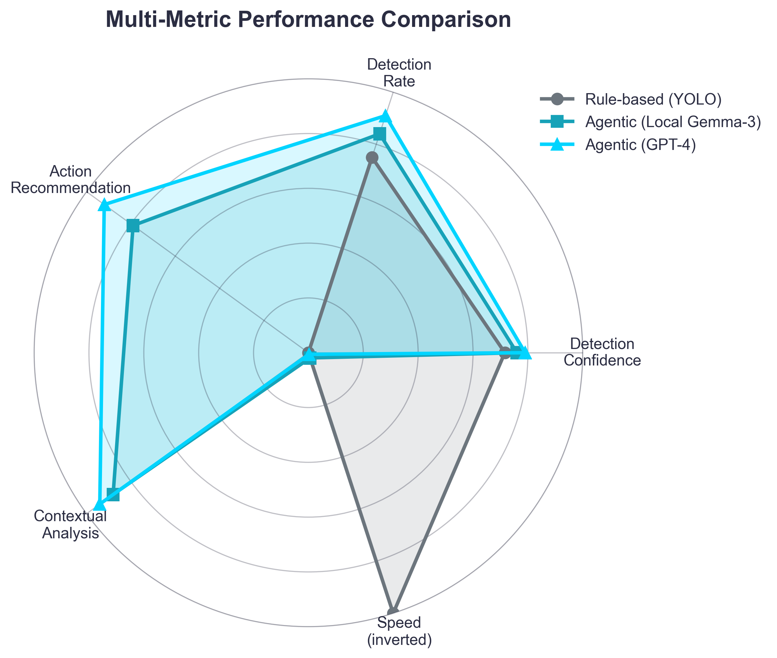
Results: Multi-Metric Comparison
Trade-off Analysis:
▶ YOLO excels at speed only
▶ Agentic systems dominate in:
▷ Contextual understanding
▷ Action recommendation
▷ Ecosystem integration
▶ Local Gemma-3: 70% faster than GPT-4
Recommendation
Hybrid architecture: YOLO for screening, LLM for critical cases
A. Koubaa & K. Gabr
SmartTech 2025
13 / 16

Slide 14
Main Findings
Finding 1: Superior Detection
Agentic UAVs achieve 0.79 confidence vs 0.72 baseline, 91% detection rate vs 75%
Finding 2: Autonomous Decision-Making
92% action recommendation rate (rule-based: 0%) — qualitatively new capability
Finding 3: Computational Trade-off Justified
Modest overhead (~5s) enables contextual reasoning, ecosystem integration, and reduced operator dependence
Overall: Computational cost is an investment that elevates UAVs from passive sensors to intelligent agents.
A. Koubaa & K. Gabr
SmartTech 2025
14 / 16

Slide 15
Future Work
Short-term:
▶ Field trials in controlled outdoor environments
▶ Hybrid local-cloud deployment optimization
Long-term:
▶ Scalable swarm cognition for multi-UAV collaboration
▶ Safety assurance for LLM-driven decision-making
▶ Regulatory compliance and UTM integration
Limitations:
▶ Current validation is simulation-based (sim-to-real gap)
▶ Real-world factors (wind, GPS degradation) need testing
A. Koubaa & K. Gabr
SmartTech 2025
15 / 16

Slide 16
Questions?
Prof. Anis Koubaa
AlfaisalX Center of Excellence
Alfaisal University, Saudi Arabia
akoubaa@alfaisal.edu
aniskoubaa.org
SmartTech 2025
January 14–16, 2025 | Tunis, Tunisia

